Slide 1

ITAHARI NAMUNA COLLEGE TEAM A
presents
Health made simple, Care made personal

Slide 2
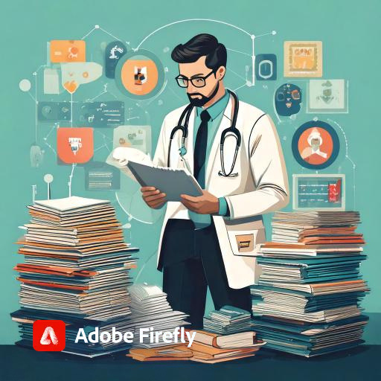
problems that we are trying to tackle
Lack of a unified system for medical records
Insurance processes are outdated and confusing
lack of personalized AI health assistant
ambiguous talk between the patient and doctor leads to issues

Slide 3
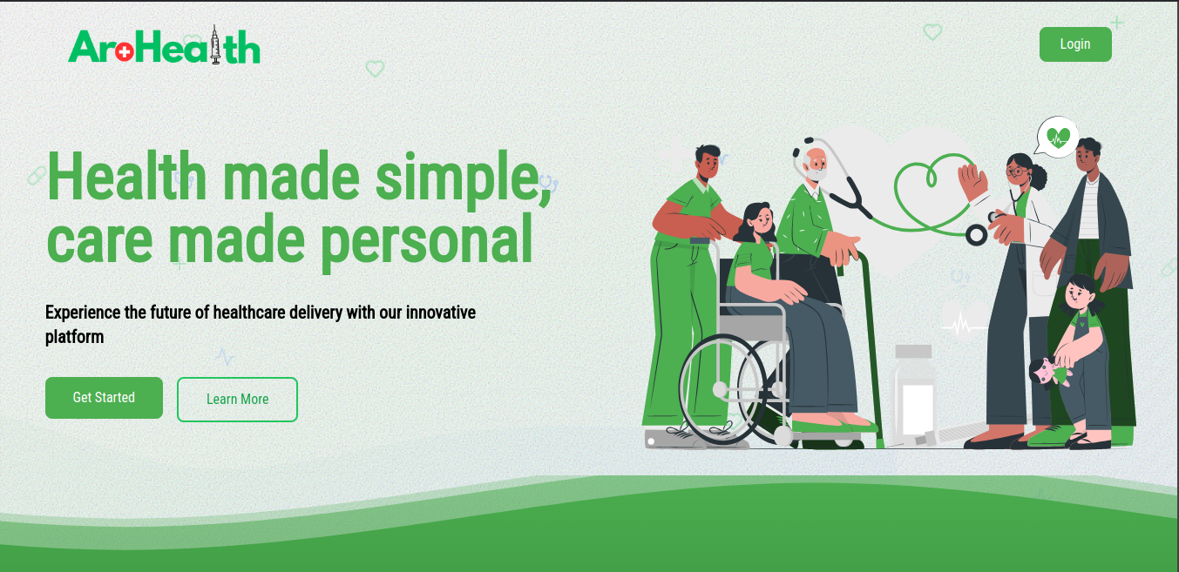
What is the solution,then ?
AroHealth is a SaaS platform connecting users, doctors, and insurance companies in one ecosystem. It tracks insurance plans, stores medical histories, and provides an AI companion, ‘Arogen,’ for personalized health advice. It’s like LinkedIn for healthcare, but better!

Slide 4



WHY
Instant access to patient data and seamless record updates.
Hospital
patient
Insurance
companies
For Users: Simplified health tracking, AI-powered assistance, and secure access to medical records.
Real-time tracking of claims and user insights.

Slide 5

BUSINESS MODEL & REVENUE STREAMS
AroHealth will operate on a B2B SaaS model
Insurance companies purchase the platform and provide it to users as part of their plans
Insurance companies will onboard the hospitals to our app as well for better insurance tracking with additional user care feature
Our revenue comes from subscription fees that we charge to the Insurance companies as per the number of users they onboard

Slide 6


CHANNELS TO REACH TARGET CUSTOMERS
OUR END USERS ARE THE GENERAL PEOPLES
reaching the end user is very very difficult so we partner up with the insurance company since they have access to our large customer base and adding just some morre features on top for insurance companies reduces our marketing effort and helps us crack the market easily

Slide 7

TALK IS CHEAP,
LETS SEE SOME ACTION
Lets have a look at our MVP

